Slide 1
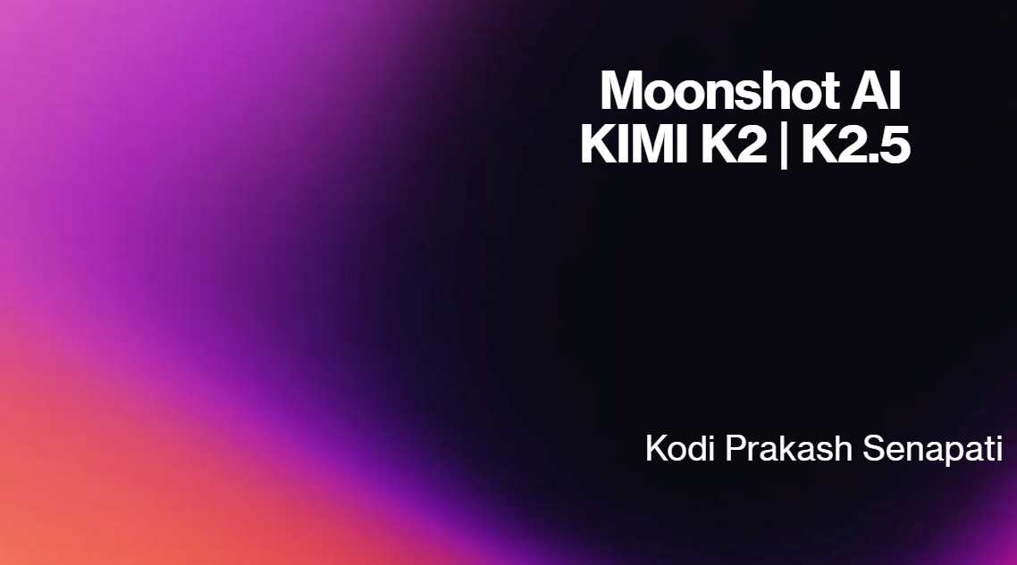

Slide 2
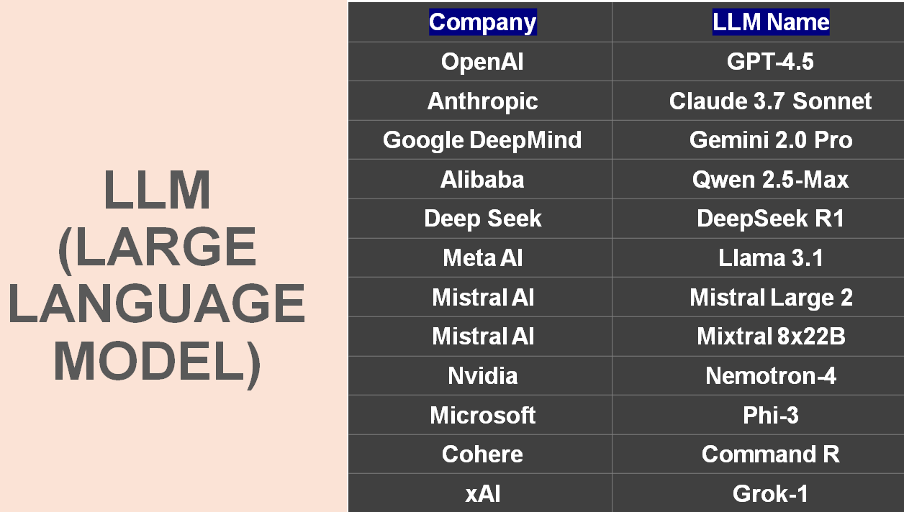

Slide 3
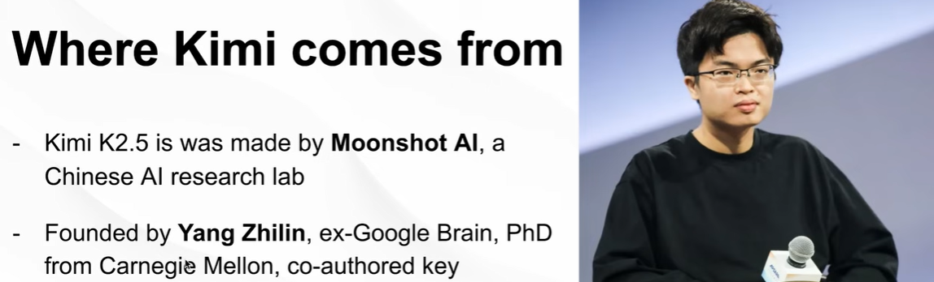
What is Kimi K2, 2.5 ?
Kimi is an artificial intelligence chatbot. Kimi ai is large language models developed by Chinese company Moonshot AI.
Its first version K2 was released in 2023, was known for supporting up to 128,000 tokens of context.
Kimi K2, an open-weight model released in July 2025, showed strong performances on coding benchmarks.

Slide 4
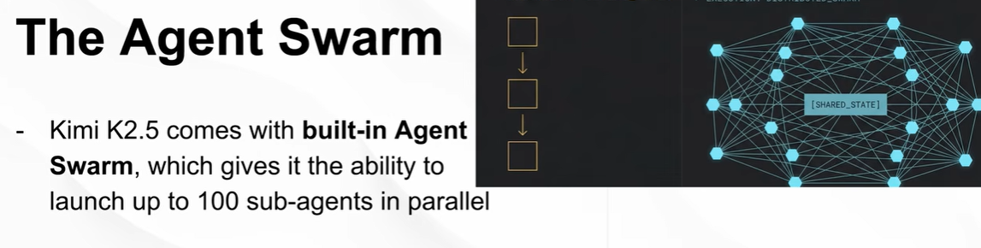
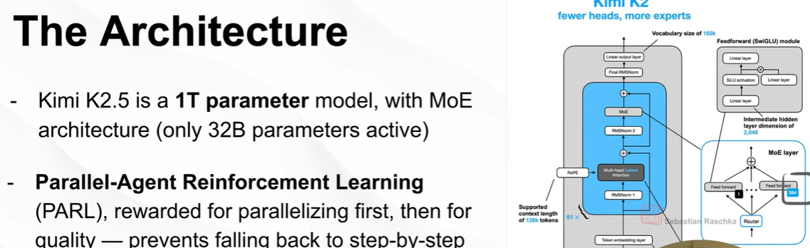

Slide 5
Let's discuss official website
https://github.com/MoonshotAI/Kimi-K2.5
https://www.kimi.com/blog/kimi-k2-5.html
https://www.moonshot.ai/
https://platform.moonshot.ai/console/api-keys
https://github.com/moonshotai
https://developers.openai.com/cookbook
https://platform.moonshot.ai/docs/guide/kimi-k2-5-quickstart#overview-of-kimi-k25-model

Slide 6
Explore Kimi model
1- Ollama
2- using OpenClaw Moonshoot Api key
3- Using Grog
4- Using Open Router
5- Using Hugging Face
6- Using Claude Code

Slide 7
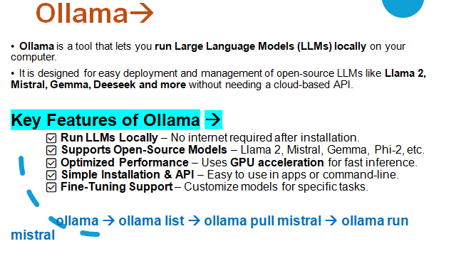

Slide 8

Previous Video Link -->
Openclaw (Part1) --
https://www.youtube.com/watch?v=QdznP9S1wS0
Agentic AI playlist --
https://www.youtube.com/playlist?list=PLVlQHNRLflP8Pt3wVlRWRaXZXi79cIwSq
==============
FSDS with Gen AI & Agentic AI @ 7:00 PM (IST) by Mr. Prakash Senapati From 2nd Jan
👉🏻Live Zoom Class Link : https://zoom.us/j/82006090582
==============

